Slide 1

Rocket Launch
Submitted By
MD FAZLEY ELAHI
Submitted To
Dr. Machbah Uddin
Associate Professor
Department of Computer Science and Mathematics
Faculty of Agricultural Engineering & Technology

Slide 2

Introduction
Rocket launch project for computer graphics using python language and using library pygame. The caption for this project is “Rocket Game” .

Slide 3
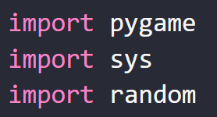
Module
Module 01: firstly, I use the library for controlling this game(project)
Then we initialize pygame and select for a window position like height and width and then give a caption and some color for showing this game .

Slide 4
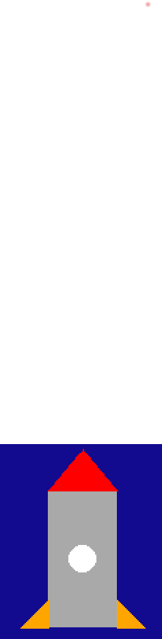
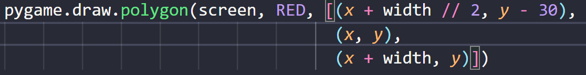

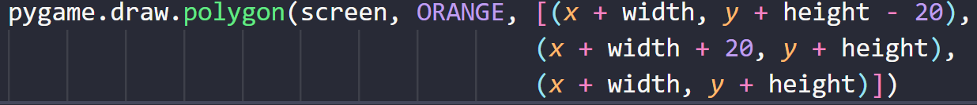

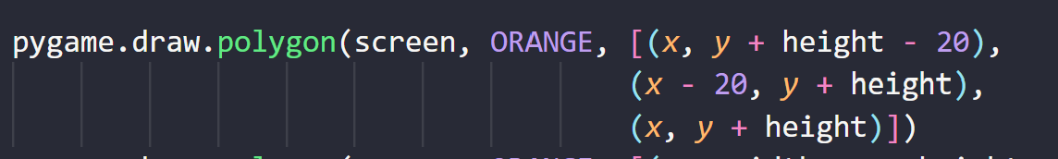
Module 02:
Now the main part is the rocket draw . The rocket has a rectangle and inside a rect. give a circle then the tip is the triangle that is red color then the wing is drawn. The rocket is the below and all calculation and coordinate point:

Slide 5

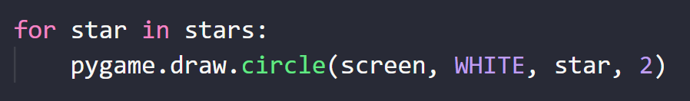

Module 03:
Secondly the moon and stars draw:

Slide 6
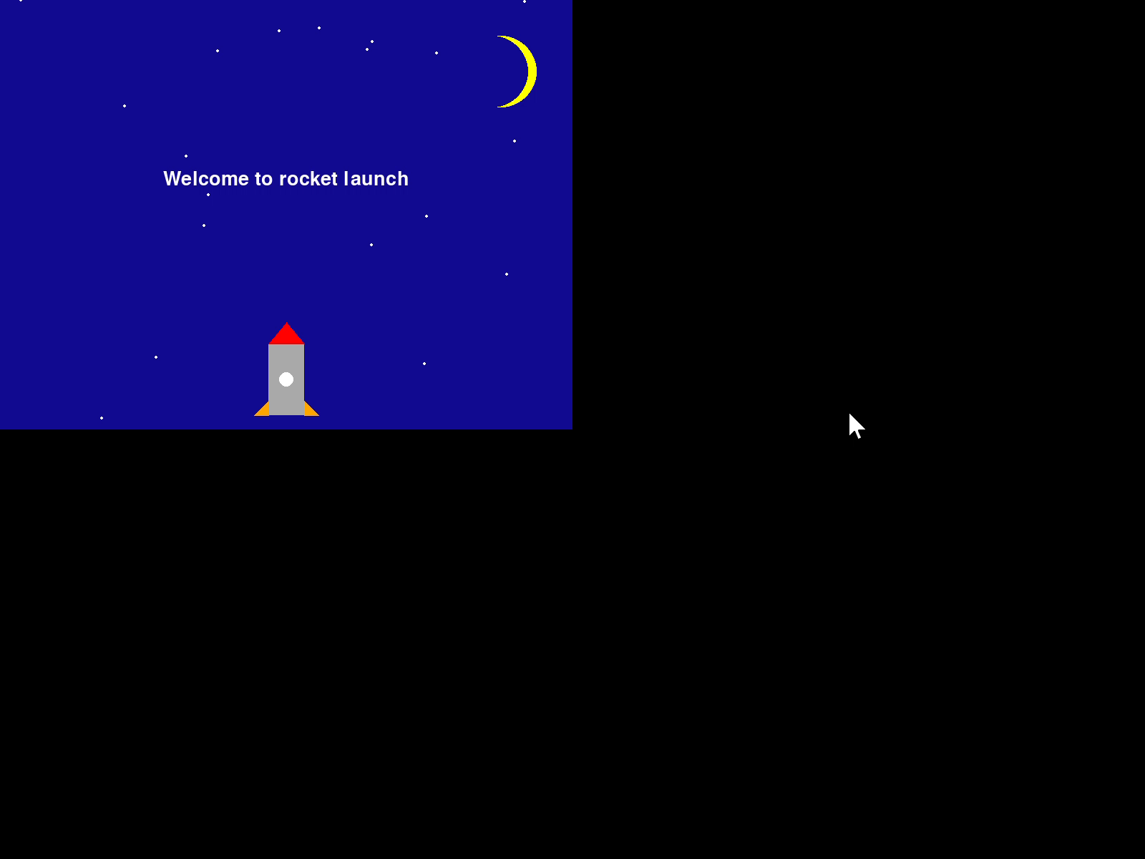
Module 04:
Now the main part begin that is the event create for this game. For this the code run the main event start and show the welcome message then countdown 10 to 1 then the rocket launch I will show a video and then the rocket launch the flame or particles create for launching a rocket then when the rocket up to the screen then I modify the screen to reset again and the rocket again flying bottom to top.

Slide 7

Conclusion
The project is my first time real project in fiverr site and if anyone to ask a question for this project feel free to ask me.

